Slide 1

MegaMAP
Graphics Review
Group CD65
[1]

Slide 2
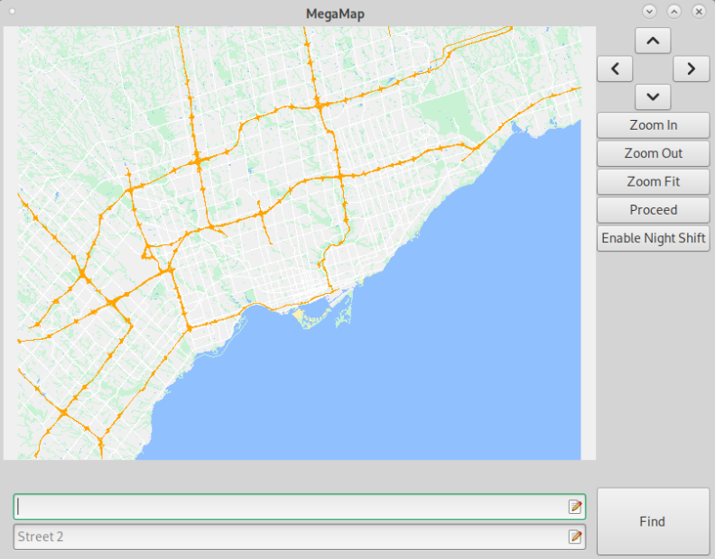
MegaMAP
Display any city around the world in their own language
Show roads, points of interest, parks and many more
Find any intersection you want with through the GUI
Fast & optimized design

Slide 3
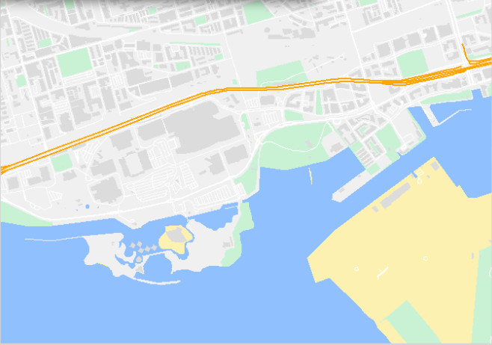
Graphics Design:
Colour Coding to Enhance Intuitive Usability

Slide 4
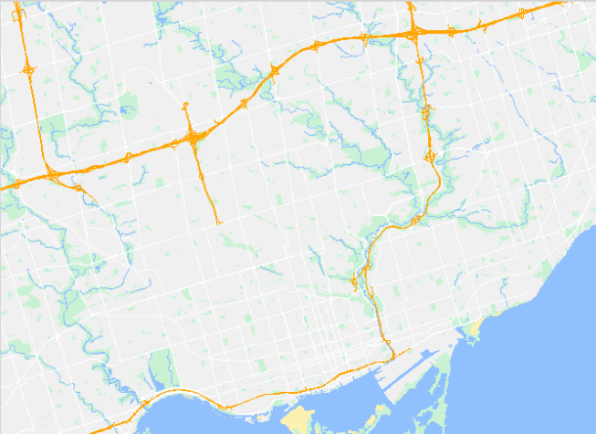
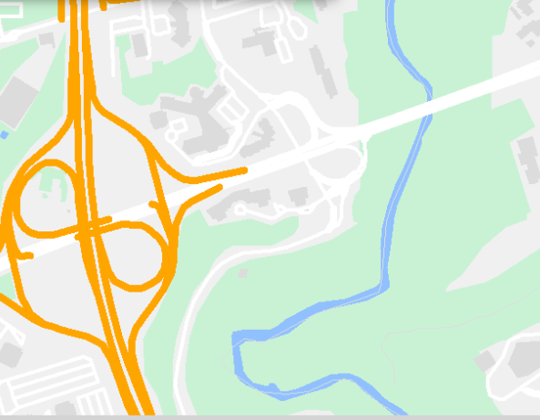
Graphics Design:
Road Thickness & Colours for Clear Distinction

Slide 5
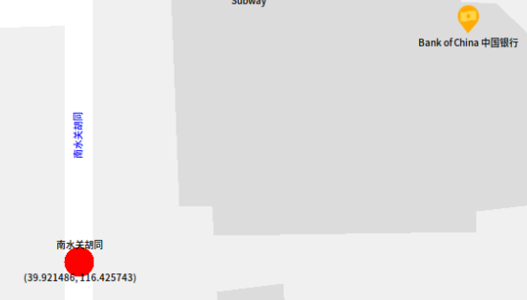
Graphics Design:
Fonts to Support Intercultural Usability
MegaMap supports alphabets in :
Chinese
Arabic
Russian
and many more languages!
Increases usability for non-English speakers.

Slide 6
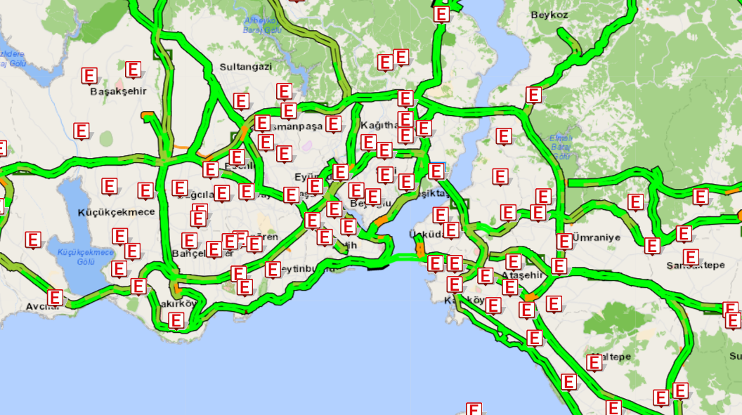
Point of Interests:
Icons to Ensure Universal Usability
[2]
Notes:
Story Time

Slide 7
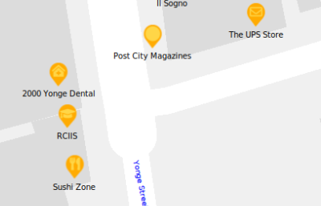
Point of Interests:
Icons to Ensure Universal Usability
MegaMap includes 20+ universal icons
Accessible for everyone
Easy to locate

Slide 8
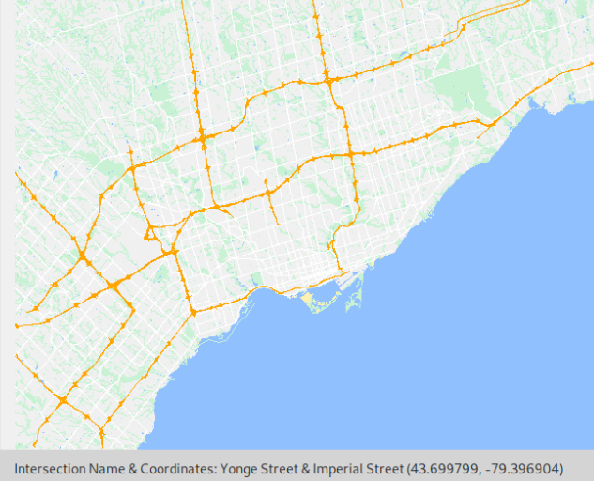
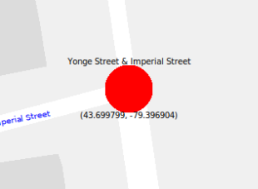
Highlighted Intersections:
Find Out Where You Are
Simple! Just click on it.
click
Display Information

Slide 9

Demo: Highlighting Intersections
Notes:
Ask the audience!

Slide 10
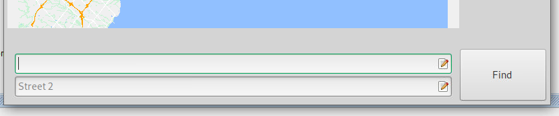
How do I find the intersections I want?
With this little thing
|
v

Slide 11
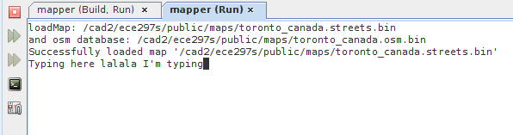

Search Box:
Utilize the GUI, not the Terminal
One screen is all you need

Slide 12
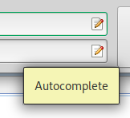
Autocomplete:
No need to remember all the names
Spend less time typing names
Fetch the first match
Click to Autocomplete

Slide 13

Find Button:
Finding what you need with a single click
Find the intersections between two streets
It even pans and zooms for you!

Slide 14
Demo: Finding Intersections

Slide 15
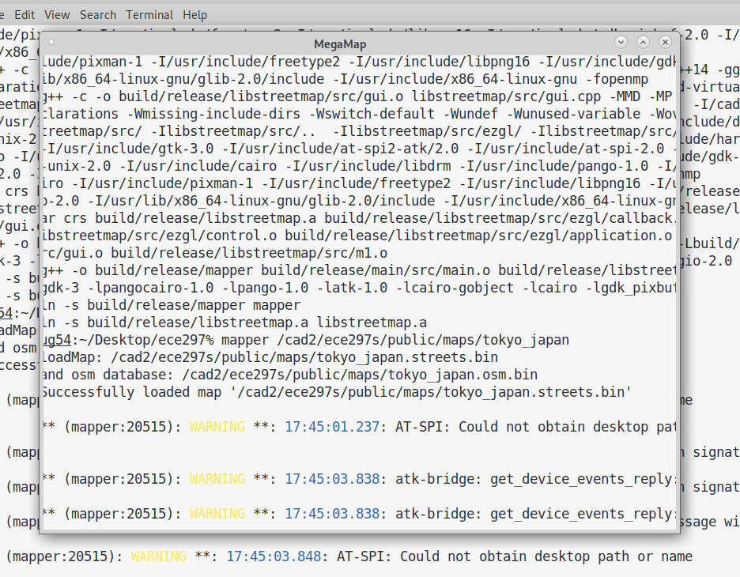
Optimisations
for Responsiveness and Usability
Keep this from happening

Slide 16
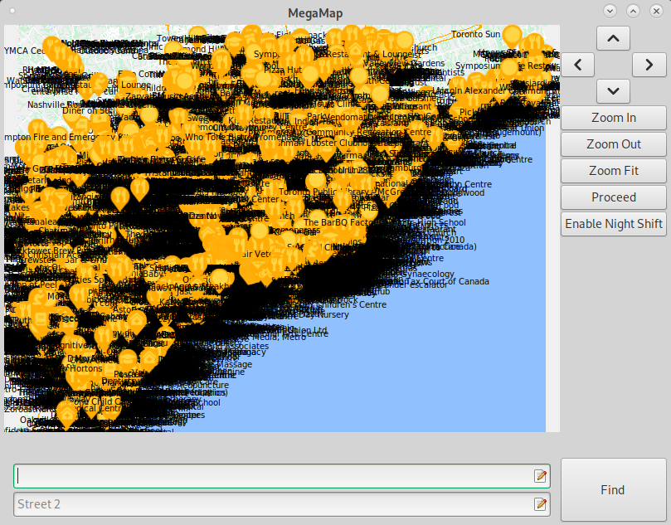
Smaller Features Hidden When Zoomed Out
Avoiding Clutter to Increase Usability
Too much information makes it harder to decide [3].
Likewise, too many graphics makes maps harder to look at.
Notes:
Information overload

Slide 17
Demo: Horrible

Slide 18
Demo: Slightly Better

Slide 19
Demo: The Best

Slide 20
500ms
Average redraw time in Toronto
Notes:
Google Maps takes ~200ms according to our qualitative testing

Slide 21
Conclusion
MegaMap provides an optimal user experience with design made to facilitate navigation and utilization.
With methods of reducing the amount of graphics drawn, MegaMap provides a responsive and fast experience.

Slide 22
Mega usability
Mega responsiveness
MegaMAP

Slide 23
List of References
[1] “simple world map outline vector fresh world map vector outline free refrence world map vector free of si...: World map outline, World map silhouette, Blank world map,” Pinterest, 13-Feb-2021. [Online]. Available: https://www.pinterest.ca/pin/735353445386167705/. [Accessed: 22-Mar-2021].
[2] ”IMM Traffic Density Map [Istanbul, Turkey]” [Online] Available:https://uym.ibb.gov.tr/yharita6/# [Accessed: 28 Feb 2021]
[3] P. G. Roetzel, “Information overload in the information age: a review of the literature from business administration, business psychology, and related disciplines with a bibliometric approach and framework development,” Business Research, 06-Jul-2018. [Online]. Available: https://link.springer.com/article/10.1007/s40685-018-0069-z. [Accessed: 22-Mar-2021].
[4] A. A. 09, “Sweet Brown / Ain't Nobody Got Time for That,” Know Your Meme, 06-Jun-2019. [Online]. Available: https://knowyourmeme.com/memes/sweet-brown-aint-nobody-got-time-for-that. [Accessed: 22-Mar-2021].

Slide 24
Thank you for listening!
Any Questions?

